Slide 1
Supporting Information
For
Value Analysis/
Product Committee

Slide 2
Discussion Points
What is toilet plume aerosol and what dangers does it pose?
How does the Splashblocker® help reduce exposure to toilet plume aerosol?
How using the Splashblocker® makes financial and environmental sense for your facilities along with health sense for your nurses, caregivers, patients and visitors.

Slide 3
Toilet Plume Aerosol is the dispersal of microscopic particles as a result of flushing a toilet.
“The potential risks associated with toilet plume aerosols produced by flush toilets is a subject of continuing study…The studies demonstrate that potentially infectious aerosols may be produced in substantial quantities during flushing…Research suggests that toilet plume could play a contributary role in the transmission of infectious diseases.”
American Journal of Infection Control, March 2013, David L. Johnson, Univ. of Oklahoma
“University of Iowa research demonstrates that toilet flushing generates aerosols that could contribute to the spread of highly contagious viruses, such as norovirus and other viral pathogens including SARS-CoV-2, the virus that causes COVID-19.”
“The researchers noted that staff in health care facilities, including nurses, doctors, and custodial workers, may be vulnerable to exposure because they often do not use respiratory or barrier protection when flushing toilets.”
University of Iowa, College of Public Health, January 20, 2022
“The toilet should be covered with a plastic-backed absorbent pad while flushing. This can protect the Health Care Worker from splashing and minimize environmental contamination of Hazardous Drugs.”*
ONS Safe Handling of Hazardous Drugs, 3rd Edition, M. Polovich, PhD, RN, AOCN - Emeritus
*There is currently no data to support the effectiveness of using plastic-backed pads.

Slide 4
Toilet Plume Exposure Survey: 2022 ONS Congress, Anaheim, CA
N=217 oncology nurses
Level of concern when flushing toilet
(1=low, 5=high)
Use of plastic-backed pad
Use of respirator when flushing
Biggest concerns when flushing
(Total > 100%)

Slide 5
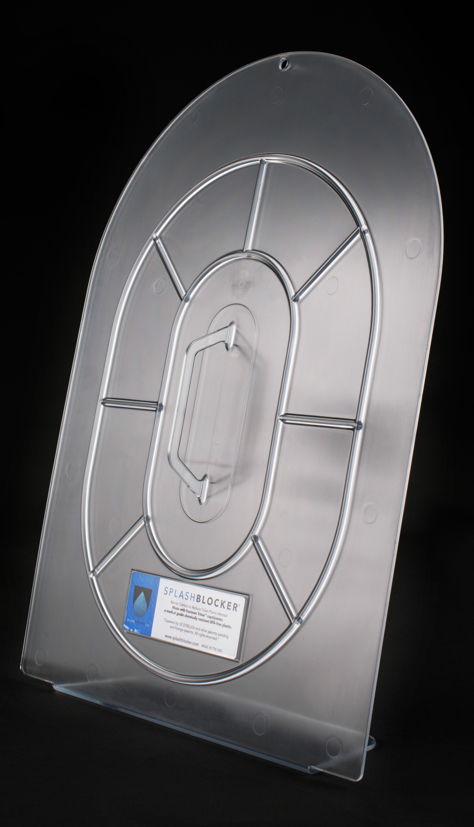
Splashblocker®
Invented by oncology nurse Linda Dick (Temple Jeanes Hospital) and her husband Bill to help protect herself and her fellow oncology nurses.
Solid, one-piece construction. Made with Eastman Tritan copolyester, a medical grade, chemical resistant, BPA-free, clear plastic. Weight: 1.75 lbs.
Easily hung on wall after use (adhesive wall hook provided) or can rest on floor using integrated flange if preferred. Cost: $150 per Splashblocker unit.
Easy to clean using hospital bleach wipes.

Slide 6
“It helps protect me when disposing of bodily fluids of patients receiving chemotherapy. It’s an extra line of protection against exposure.”
“I feel I am protecting myself better since I am in a hurry and don’t always follow all of the hazardous drug precautions.”
“I feel more confident emptying urinal and urine catchers. I don’t have to worry about the risk of anything splashing back on me.”

Slide 7
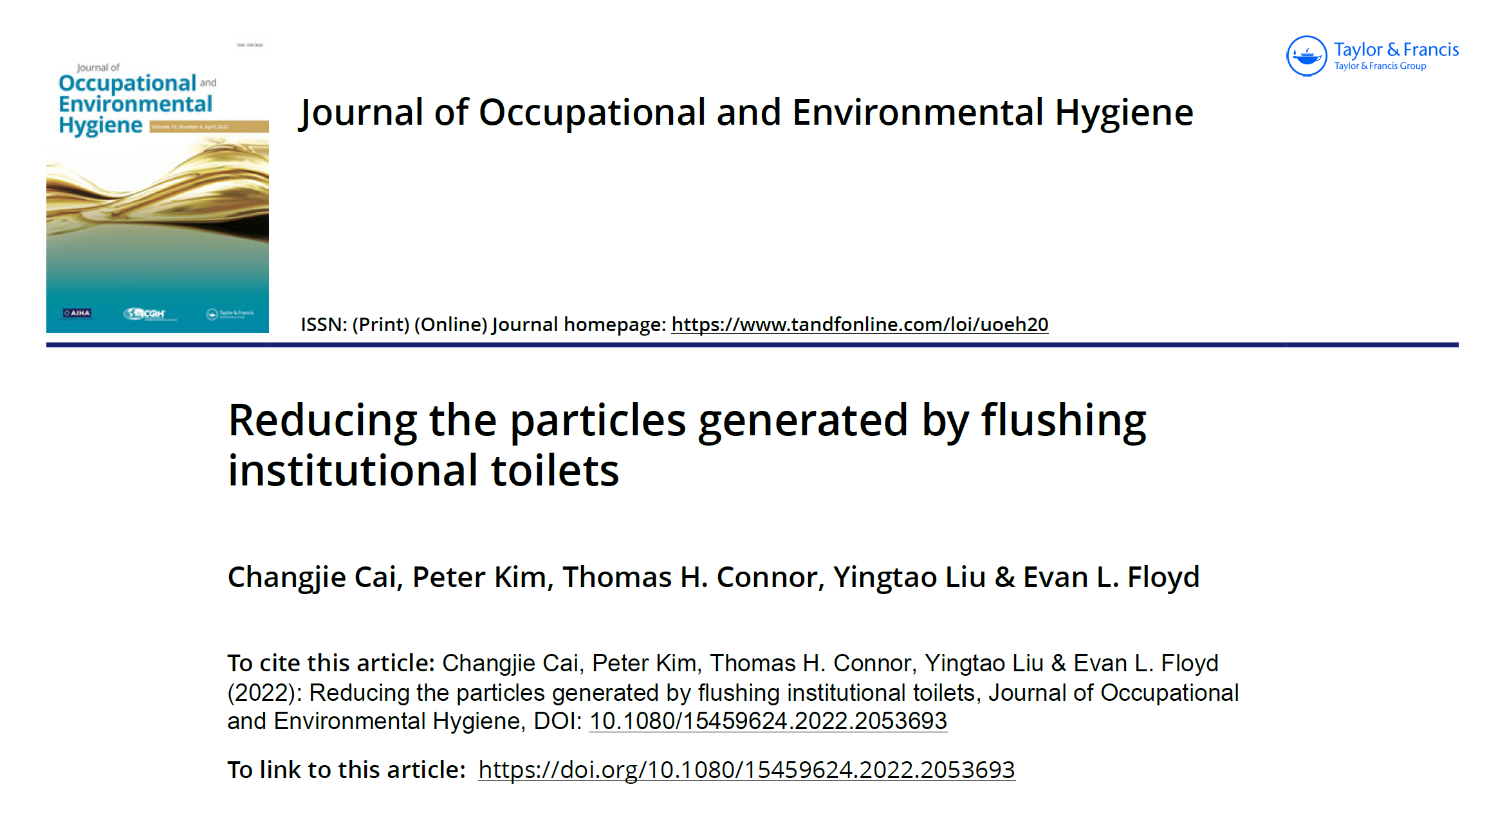
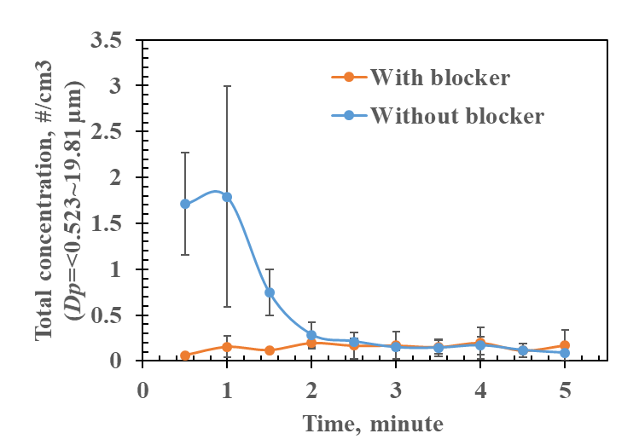
Study Purpose:
Evaluate the effectiveness of the Splashblocker in reducing number, surface area, and mass concentration of particles generated by a hospital toilet.
Results:
Particles were significantly reduced, particularly during the first 90 seconds when the highest concentrations occur.
Published May 2022
APS Measurement
(Particles from 0.52-20 µm)

Slide 8
What Leaders Are Saying:
“As oncology nurses, we’ve been concerned for decades about the risk of exposure to hazardous drugs (HDs) when flushing a toilet. We know what’s in excreta and there’s ample evidence to support this. While our guidelines have recommended covering the toilet with a disposable plastic-backed pad, we’ve never had scientific evidence to demonstrate efficacy, and there have been ongoing concerns regarding cost, environmental, and plumbing issues. We now have scientific evidence to demonstrate how the Splashblocker® significantly reduces exposure and environmental contamination.”
Seth Eisenberg, RN, OCN, BMTCN Member of Study Team

Slide 9
What Leaders Are Saying:
“For over twenty years, NIOSH has been researching methods for reducing or eliminating exposure to HDs. Organizations such as ONS have adopted NIOSH guidelines into their own guidelines, and have included engineering controls, administrative controls, and personal protective equipment (PPE). We know that PPE does not prevent environmental contamination and that HDs can be transferred throughout the healthcare facility.”
“The Splashblocker is an engineering barrier control that protects workers from aerosols generated from flushing institutional toilets which may contain HDs and their metabolites, or infectious agents such as bacteria or viruses. As such, it joins other engineering controls such as biological safety cabinets and closed system transfer devices which are designed to protect the healthcare worker and environment.”
Thomas Connor, PhD Retired Research Biologist, NIOSH Study Designer

Slide 10
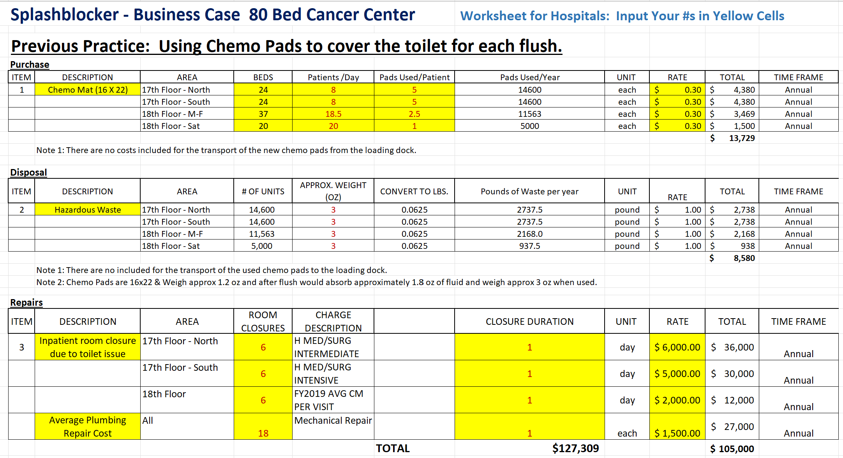

Slide 11
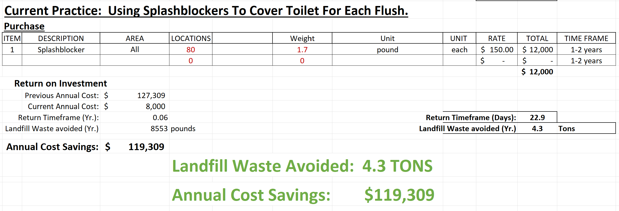

Slide 12
Summary
Toilet plume aerosol is a serious health risk to nurses, caregivers, patients and visitors.
The Splashblocker® helps reduce the risks from toilet plume aerosol by blocking the danger at the source, the toilet.
The reusable Splashblocker® enhances safety for your nurses, caregivers, patients and visitors, while saving your facility significant $$$ and being environmentally friendly.

Slide 13
Recommendation
While you will eventually want a Splashblocker in every bathroom, we recommend starting with a trial on 2-3 floors;
30-50 Splashblocker units at $150 each.
Additional Splashblocker units can be added to other floors after trial completion.

Slide 14
FAQs:
Q: How do you clean the Splashblocker?
A: We recommend using standard hospital bleach wipes.
Q: How long will the Splashblocker last before it needs to be replaced?
A: Due to the reduction of the clarity from routine use of the bleach wipes, the units should be replaced every 12-18 months.
Q: Is the Splashblocker recyclable?
A: Yes. When new Splashblocker units are placed in your facility, the old ones will be put in the shipment boxes and sent to the recycling center (labels provided).

Slide 15
For More Information or Additional Resources
Please Contact:
Brian P. Crawford
CEO & Co-Founder
Splashblocker, LLC
407-409-1444
brian.crawford@splashblocker.com

Slide 16
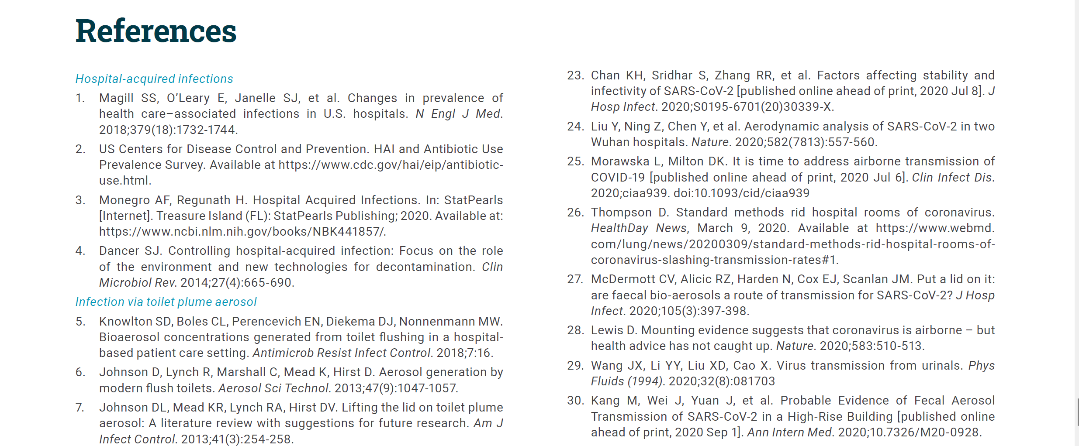

Slide 17
